Slide 1

FOR TEACHERS, CO-OPS & MICROSCHOOLS
See your whole class at a glance.
Every student gets a one-on-one tutor. You get the classroom view.
MyTutor · with Mr. Cadabra · mrcadabra.com
Notes:
If you teach math to more than one student — a co-op, a microschool, or a classroom — here's what MyTutor looks like from the front of the room.

Slide 2
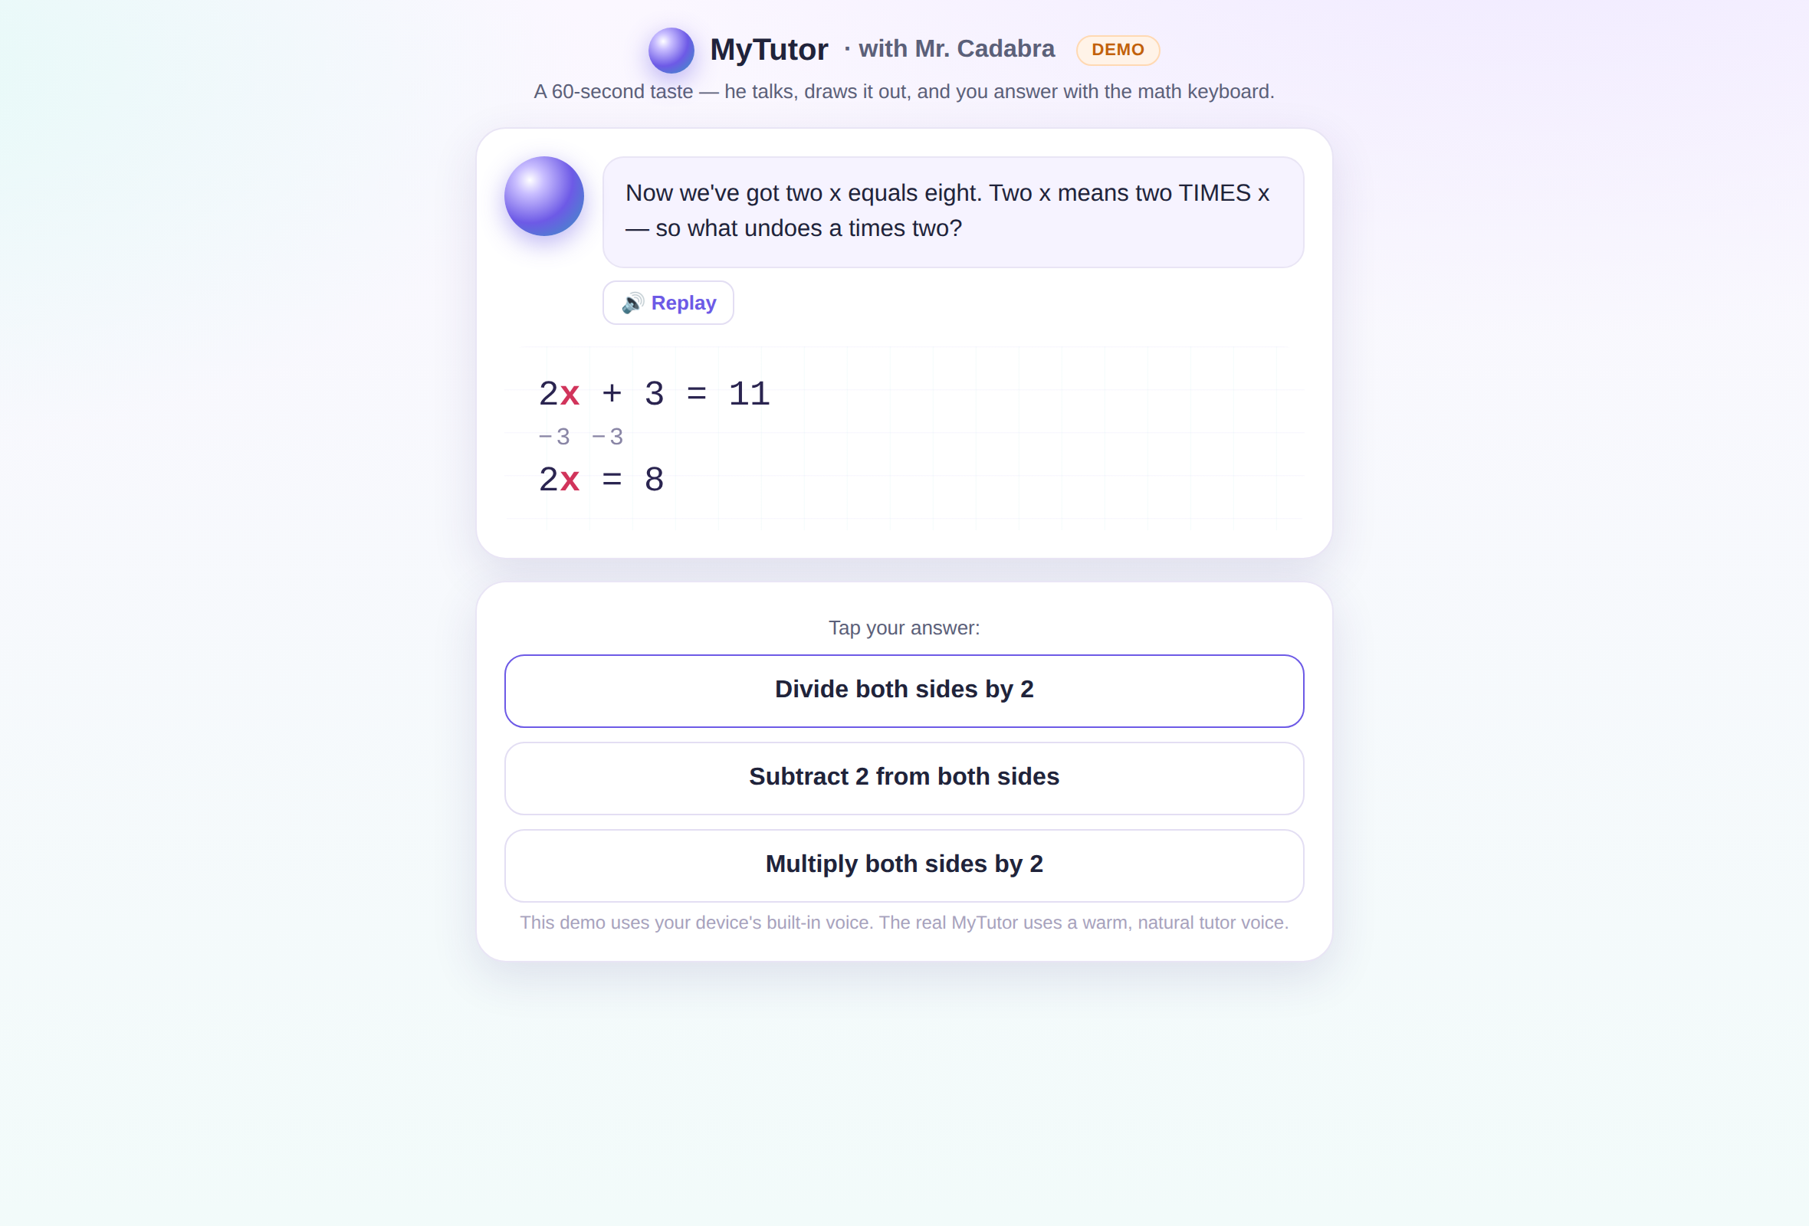
Every student, tutored one-on-one.
Mr. Cadabra teaches each student individually — out loud, Socratically, at their own placement level. A 9th grader can rebuild fractions without ever seeing a grade label.
Notes:
Every student in your class gets the same patient one-on-one tutor, working at their own placed level. That means intervention without stigma — a ninth grader can quietly rebuild fractions without ever seeing a grade level on screen.

Slide 3
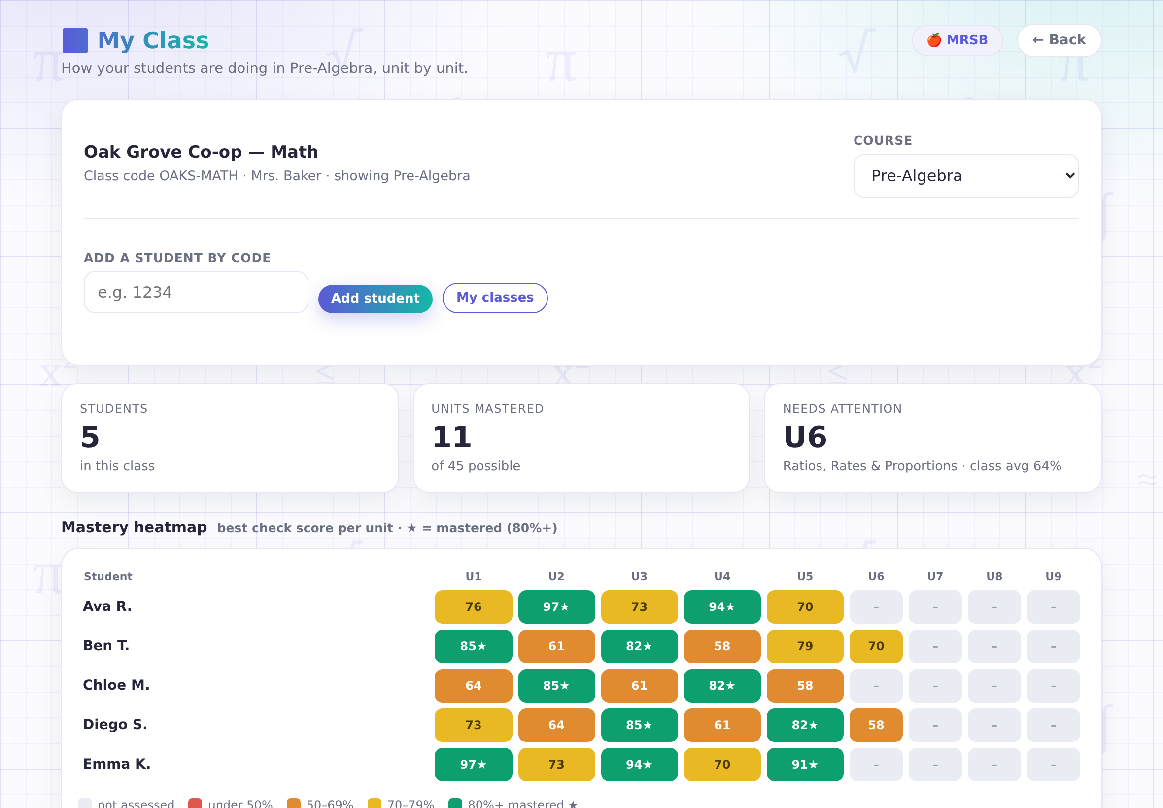
The mastery heatmap.
Best check score per unit, per student — gold star at 80%+. "Needs attention" names the unit your class is actually weakest on. Real scores, not participation points.
Notes:
This is your classroom view: the mastery heatmap. Every cell is a student's best real check score on a unit — gold stars mean mastered. And 'needs attention' names the unit your whole class is weakest on, so you know exactly what to reteach.

Slide 4
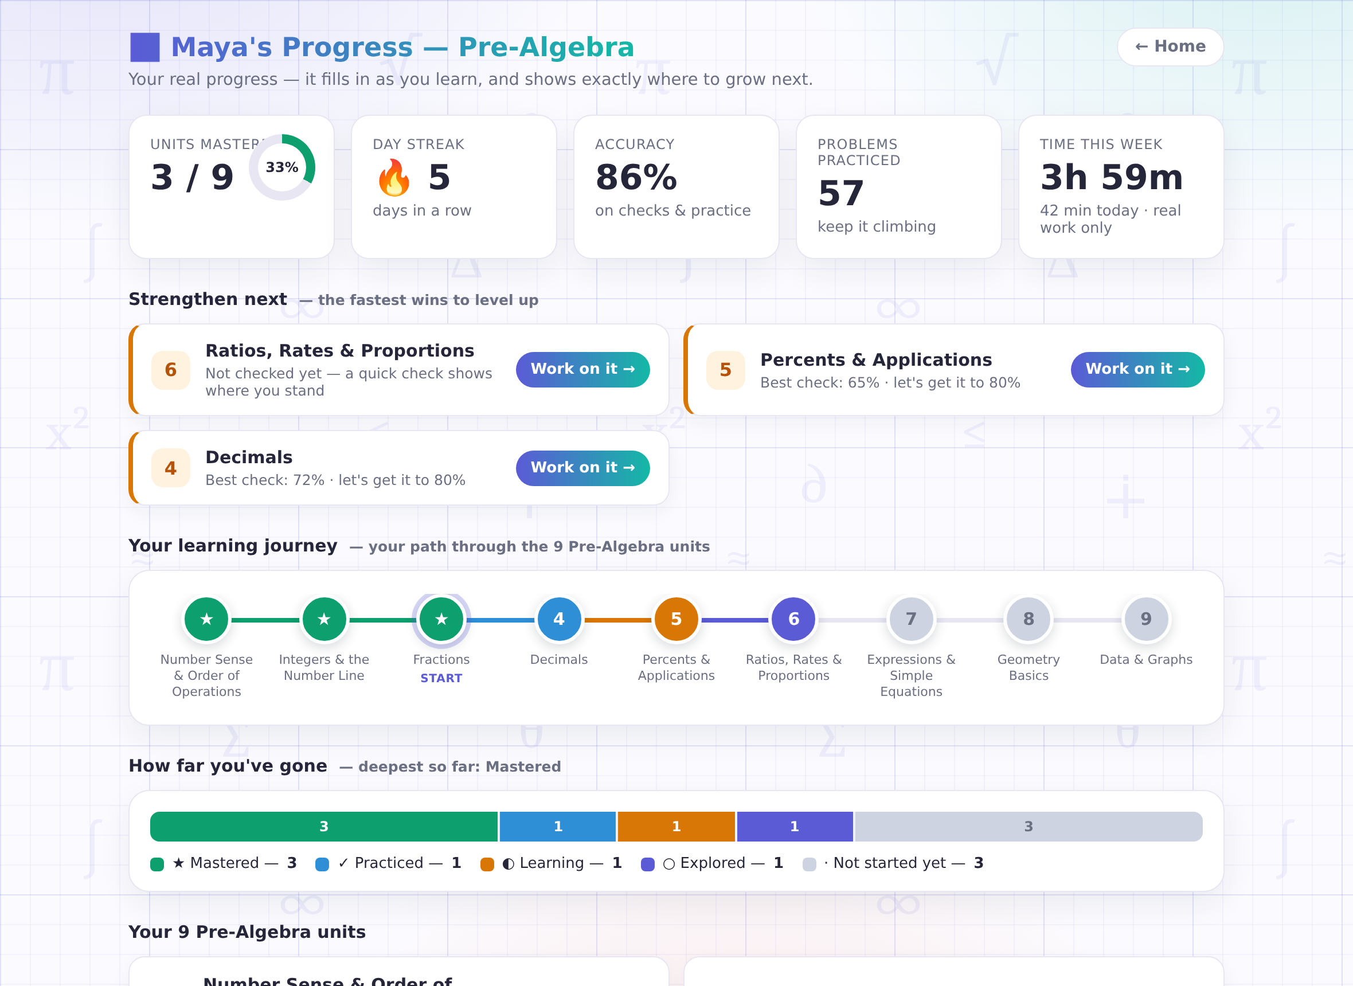
Drill into any student.
One click opens any student's full dashboard: units, accuracy, streak, and honest time-on-task — idle time never counts.
Notes:
Click any name and you get that student's full dashboard — their units, their accuracy, their streak, and honest time-on-task where idle minutes never count. It's the picture you'd build by hand, already built.

Slide 5
Built for real classrooms.
📋
🔇
📝
Roster by code
No microphones
Assessments included
Add students with their login codes — no student emails, no new personal data collected.
The tutor talks, students type. Headphones are all your room needs.
A friendly course assessment maps each student's strengths and recommends a path.
Notes:
It's built for the realities of a classroom. You add students by code — no student emails, no new personal data. There are no microphones to manage; headphones are all you need. And the built-in course assessment maps each student's strengths for you.

Slide 6
Pilot it free this term.
A limited number of classrooms get MyTutor free — we get your honest feedback.
support@mrcadabra.com
Notes:
We're partnering with a limited number of classrooms this term: you get MyTutor free for the pilot, we get your honest feedback. Email support@mrcadabra.com and tell us about your class.

